Slide 1
INSECTS OF IMPORTANCE
Bisaso M

Slide 2
Competency
Learner understands the characteristics of insects, relates the observed structures to their function and appreciate that insects have direct or indirect effects on the well-being of other organisms

Slide 3
Learning outcomes
Common examples of insects
Housefly, Cockroach, Mosquito, Bee, Butterfly and termite (6)
General characteristic features of insects
Observable external features of insects
Features on the Head, Thorax and Abdomen
Importance of the observable features for survival
Using the features to construct dichotomous keys

Slide 4
…….. continued
Identify the stages of the life cycles of insects
Housefly, Cockroach, Mosquito, and butterfly (4)
Identify the harmful stages of life cycles
Control methods
Know the useful and harmful effects of insects
Housefly, Cockroach, Mosquito, Bee, Butterfly and Termite (6)

Slide 5
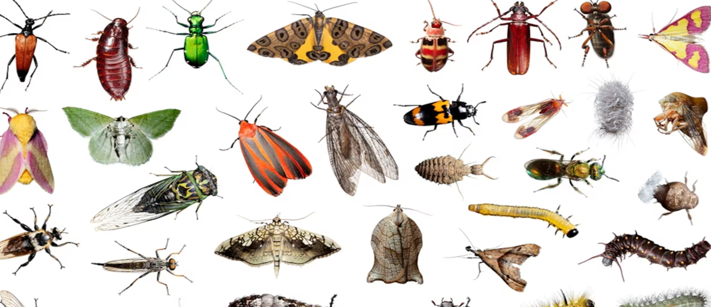
RECALL INSECTS

Slide 6
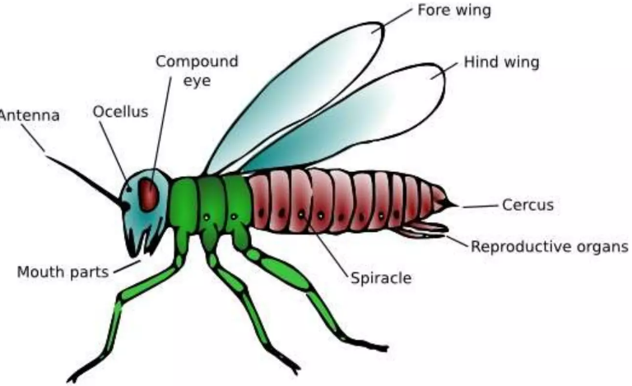
Characteristics of insects

Slide 7
Characteristics of insects
Three main body parts
Three thoracic segments
Three pairs of legs
One pair of antennae

Slide 8
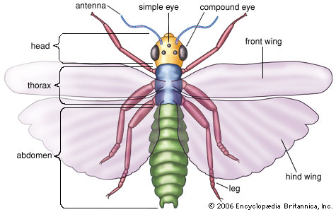

Slide 9
CLASSIFICATION OF INSECTS
Kingdom : Animalia
Phylum : Arthropoda
Class : Insecta

Slide 10
Revision Exercise
Using your knowledge of taxonomy; state the kingdom, phylum and class to which insects belong
For each of the taxonomic groups listed in qn.1 above, give reasons to support your answer

Slide 11
GENERAL EXTERNAL OBSERVABLE FEATURES OF INSECTS
Let’s explore the body parts of insects and how they are important for their mode of life

Slide 12
Generally;
The insect body is divided into three main parts
Head
Thorax
Abdomen
Each of the three divisions carries a set of structures

Slide 13

BE AS DESCRITIVE AS POSSIBLE WITH THESE FEATURES

Slide 14
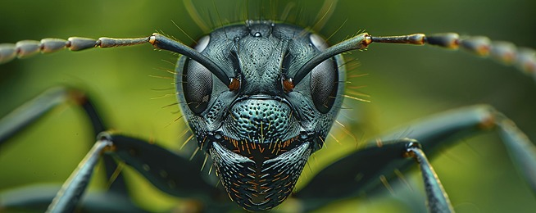
THE HEAD

Slide 15
Features on the head
A pair of compound eyes (Large/Small)
Mouth parts (Mandibles/proboscis/both)
A pair of segmented antennae (Long/Short/Hairy/hairless/Pointed/clubbed)
Some insects have simple eyes – Houseflies
Termites have no eyes

Slide 16
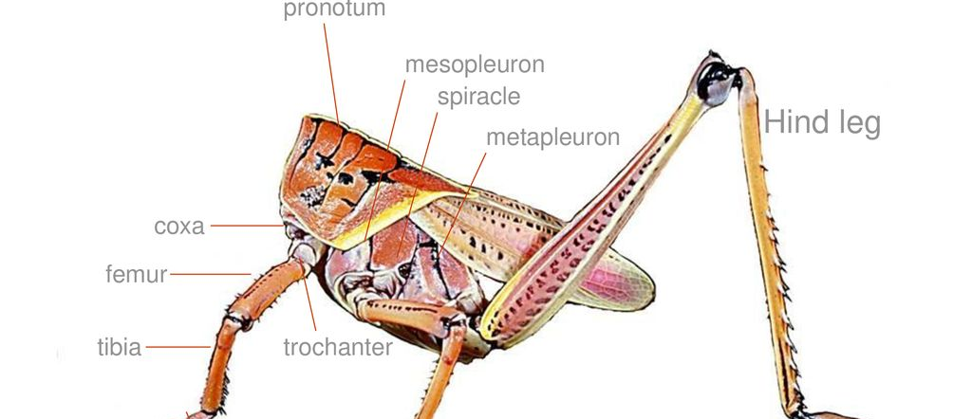
THE THORAX

Slide 17
Features on the thorax
It is divided into three segments
Prothorax
Mesothorax
Metathorax
3 pairs of jointed legs; with one pair located on each thoracic segment
Spiracles (1 pair on each segment)
Wings (2 pairs, 1 pair or 0 pairs)

Slide 18
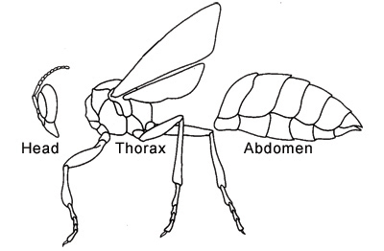
THE ABDOMEN

Slide 19
Features on the abdomen
It is segmented
Maybe rounded, pointed, elongated, hairy etc.
Spiracles; a pair on each abdominal segment – breathing routes

Slide 20
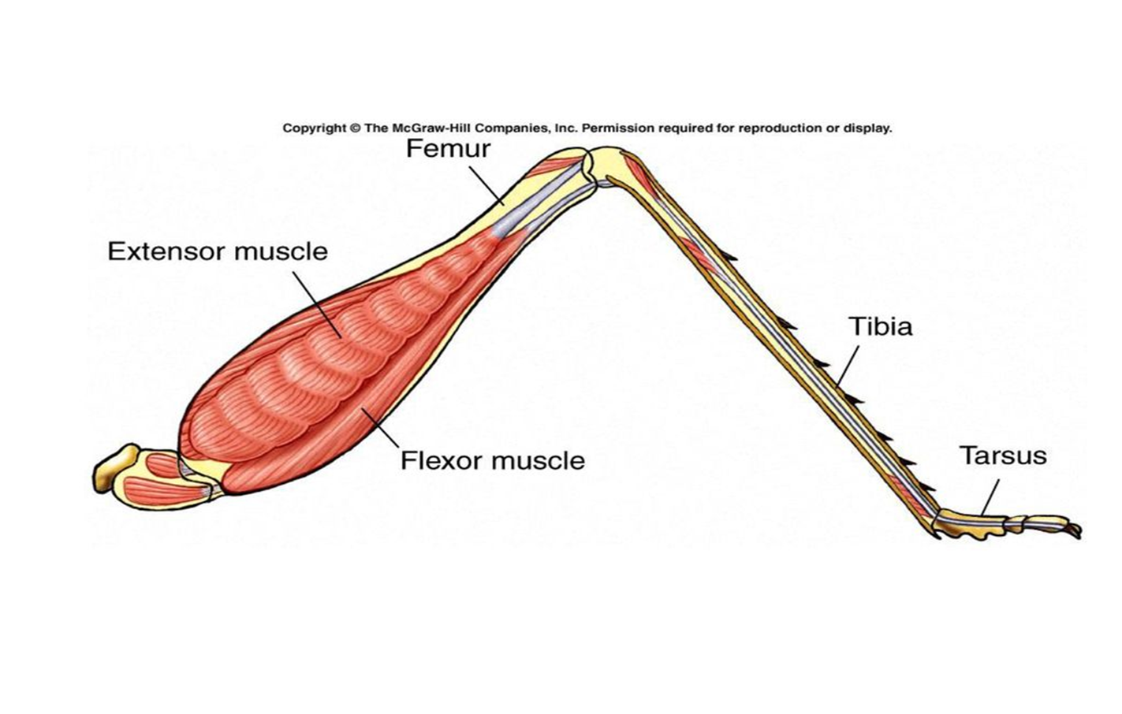
LEGS OF INSECTS

Slide 21
Insect legs are jointed
Coxa, Trochanter, Femur, Tibia and Tarsus (Foot)
Have a pad of sticky substance at the tip;
Arollium pad (For walking on smooth surfaces)
A pair of claws (For walking on rough surfaces
May be hairy (House fly, bees)
May have spines for protection (Cockroach)

Slide 22
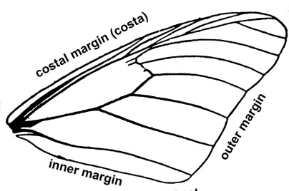
WINGS

Slide 23
About wings …..
Some insects have wings (Flight)
They may be veined (Cockroach)
May have scales (Butter flies)
Some have one pair (attached on Mesothorax) – H/fly
Some have two pairs (attached on mesothorax and metathorax) – Bees

Slide 24
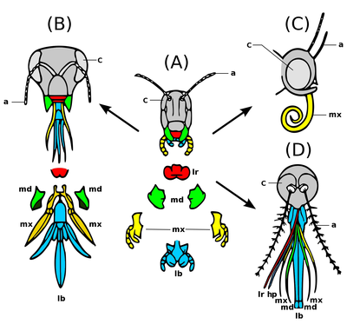
INSECT MOUTH PARTS

Slide 25
Generally
Insect mouth parts are modified according to the kind of food sources.
Some insects have sharp mandibles for biting - Cockroaches
Proboscis – for sucking – like butterfly
Proboscis with piercing stylets – mosquitoes
Bees have both mandibles (for moulding wax) and a proboscis (for sucking nectar)

Slide 26
INSECTS IN SUMMARY

Slide 27
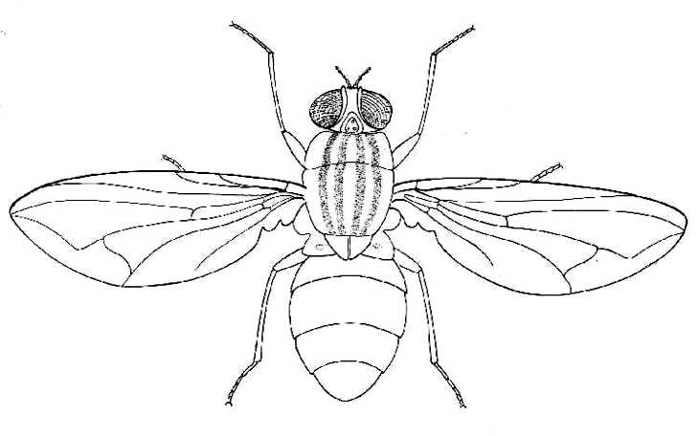
THE HOUSE FLY (Musca domestica)

Slide 28
HEAD
EYES |  | One pair of large compound eyes and 3 simple eyes
MOUTH PARTS |  | A short, hairy proboscis; with an expanded tip
ANTENNAE |  | One pair of short hairy antennae
THORAX
WINGS | One pair of membranous wings – Mesothorax A pair of balancing rods called halteres – metathorax
LEGS | 3 pairs of hairy jointed legs, with claws and a sticky pad at the tarsal end
ABDOMEN | Rounded and segmented
HABITAT | Dirty moist places
FOOD | Decomposing matter
NOTES | Has longitudinal stripes on the thorax

Slide 29
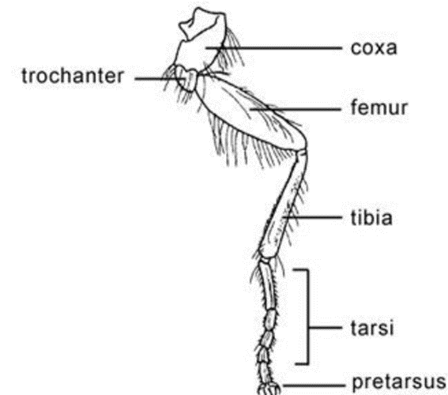

Slide 30
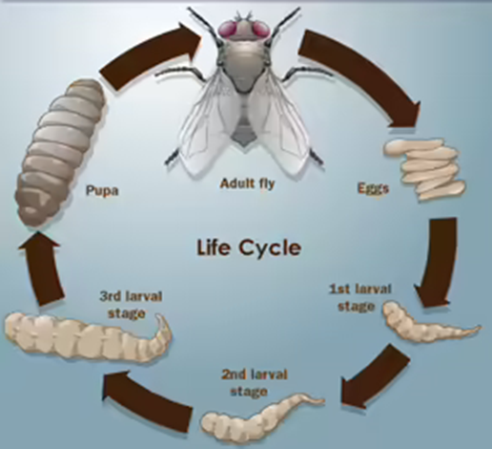
LIFE CYCLE OF THE HOUSEFLY

Slide 31
It undergoes a complete metamorphosis
After mating, a mature female housefly lays eggs on decomposing matter
The eggs hatch into larvae called maggots; which hatch into pupae.
The pupa remains dormant, until it hatches into an adult
The cycle lasts for about 10 days

Slide 32
…….. the adult is the harmful stage
It spreads diseases like cholera, diarrhea, dysentery, trachoma, ebola etc.

Slide 33
Methods of controlling houseflies
Spraying with insecticides
Covering holes of pit latrines to prevent houseflies from picking germs
Covering all the food to prevent houseflies from walking on it
4. Boiling drinking water to kill the germs

Slide 34
……. control continued
5. Washing fruits to remove germs
6. Ensuring proper disposal of feaces to prevent access by house flies
7. Washing hands with soap after visiting the latrine

Slide 35
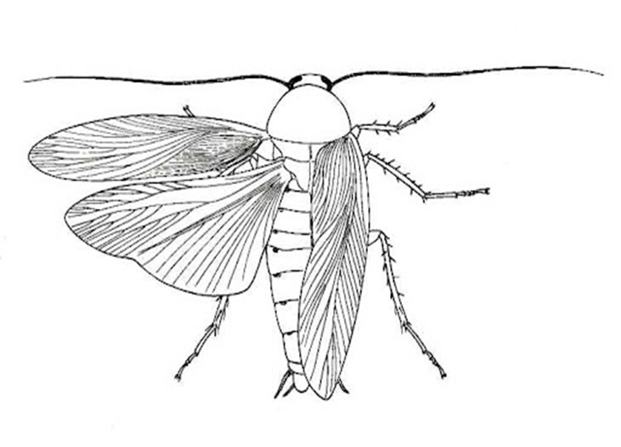
THE COCKROACH (Periplaneta americana)

Slide 36
HEAD
EYES | One pair of large compound eyes.
MOUTH PARTS | A pair of sharp serrated mandibles
ANTENNAE | One pair of long and segmented antennae
THORAX
WINGS | Two pairs of wings; dark outer (Fore) wings and membranous inner (Hind) wings.
LEGS | 3 pairs of jointed legs, with claws and a sticky pad at the tarsal end. They also have spines for protection.
ABDOMEN | Flattened, long and segmented
HABITAT | Dark places. They are nocturnal animals
FOOD | Wood, papers, textiles, leather etc.
NOTES | They are dorso-ventrally flattened to hide in cracks

Slide 37
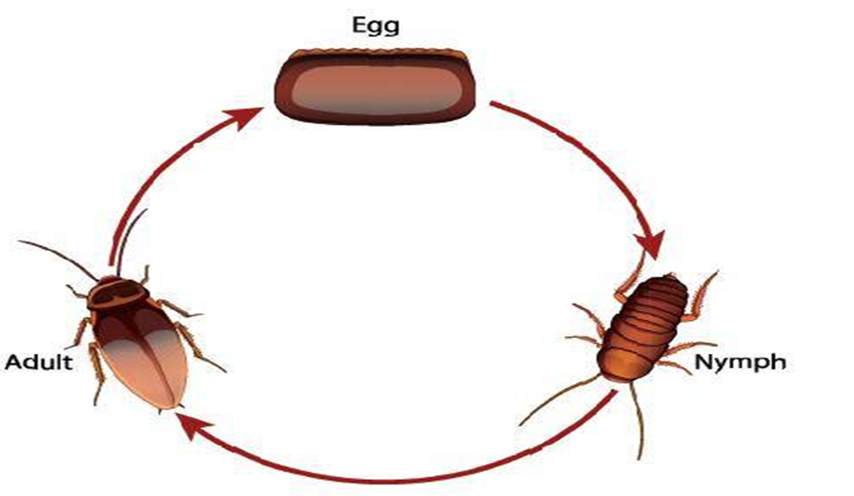
LIFE CYCLE OF THE COCROACH

Slide 38
It undergoes incomplete metamorphosis
After mating, the adult cockroach lays eggs enclosed in an egg case in a warm place.
The eggs hatch into nymphs; which are small in size and have no wings.
The nymphs moult 6 to 7 times forming an adult.
The cycle lasts for about 14 days.

Slide 39
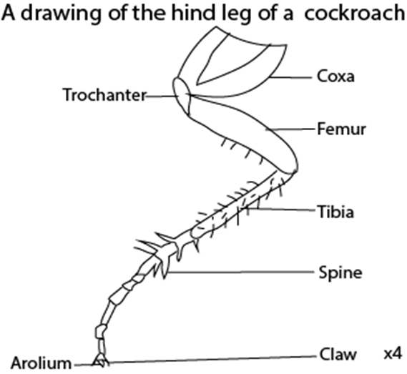
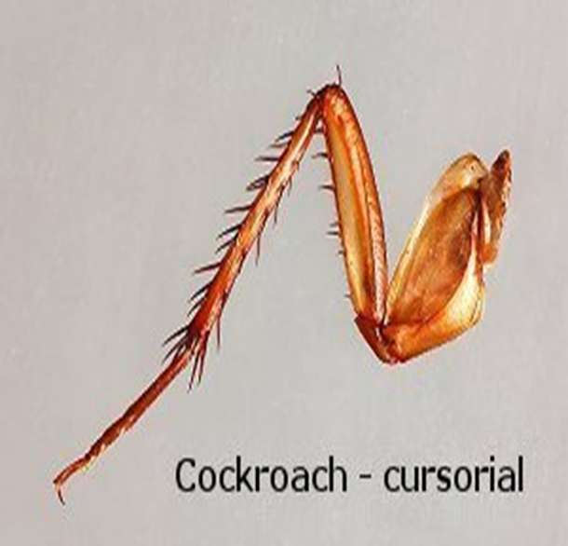

Slide 40
Assignment
You are provided with freshly killed cockroaches, observe the external features of each and answer the following questions
State the differences between inner and outer wings
Draw each of the two wings side by side to show the differences
State the structural differences between male and female cockroaches

Slide 41
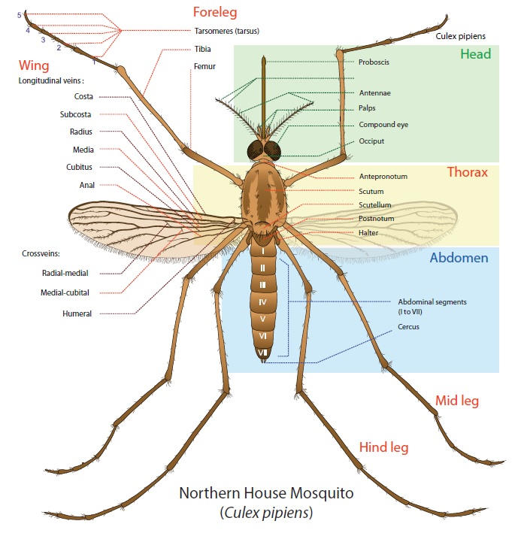
THE MOSQUITO (Anopheles gambiae)

Slide 42
HEAD
EYES | One pair of large compound eyes.
MOUTH PARTS | A long proboscis with piercing stylets
ANTENNAE | One pair of long, hairy and segmented antennae
THORAX
WINGS | A pair of membranous wings – (middle segment) A pair of halteres on the third segment
LEGS | 3 pairs of long, jointed legs.
ABDOMEN | Long, slender and segmented
HABITAT | Cool dark places. The larvae stay in stagnant water
FOOD | Juices lie nectar. Females also feed on blood
NOTES | Females need iron from blood for egg formation

Slide 43
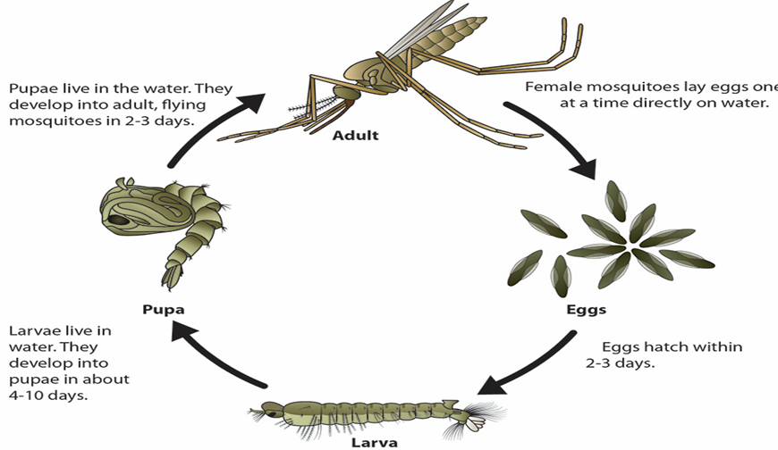
LIFE CYCLE

Slide 44
They undergo a complete metamorphosis.
After mating, the female mosquito lays eggs in stagnant water.
The eggs hatch into larvae (wrigglers)
These turn into pupa which remains dormant
The adult mosquito emerges after 15 days.

Slide 45
The adult is the harmful stage – Spreads diseases. (3 genera)
Type of mosquito | Disease | Pathogen
Female anopheles mosquito | Malaria | Plamodium
Culex mosquito | Elephantiasis | Filarial worm
Aedes (Tiger) mosquito | Yellow fever | Virus

Slide 46
Control of mosquitoes
Draining stagnant water to prevent mosquitoes from laying eggs
Clearing bushes around the home to destroy their hiding places
Pouring oil on top of stagnant water to kill mosquito larvae
Introducing small fish into ponds to feed on the mosquito larva
Spraying the mosquitoes with insecticides to kill them e.g. DDT

Slide 47
Sleeping under mosquito nets to prevent mosquito bites
Apply mosquito repellants to avoid mosquito bites
Burning of mosquito coils in the house at night to repel the mosquitoes
Removing empty containers which are the breeding places of mosquitoes.
Using electronic traps to trap mosquitoes

Slide 48
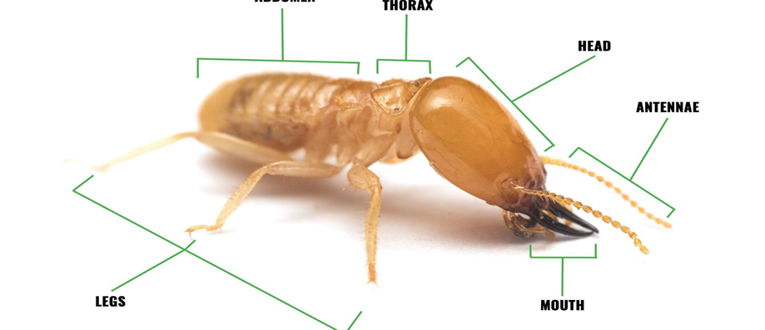
THE TERMITE (Incisitermes minor)

Slide 49
HEAD
EYES | They have no eyes
MOUTH PARTS | A pair of sharp curved mandibles
ANTENNAE | One pair of long, and segmented antennae
THORAX
WINGS | They have no wings
LEGS | 3 pairs of jointed legs
ABDOMEN | Smooth and segmented
HABITAT | They stay in the soil
FOOD | Wood, papers, plant materials
NOTES | Termites are social insects.

Slide 50
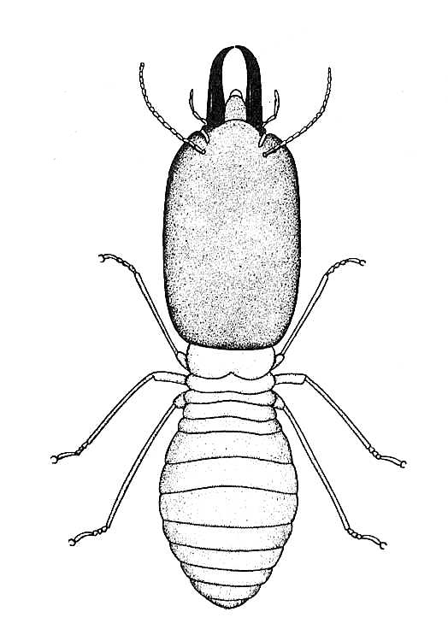

Slide 51
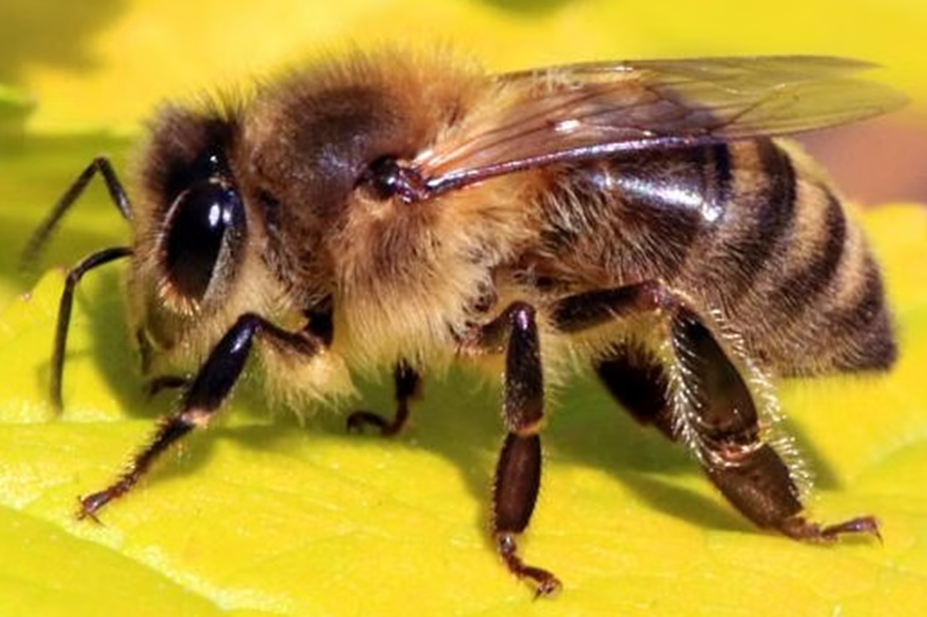
THE HONEY BEE (Apis mellifera)

Slide 52
Mode of life
Bees are social insects that live in a beehive.
There are three types of bees (castes)
The queen - the only fertile female (lays eggs)
Drones – the male bees (mate with the queen).
Drones have no sting, pollen baskets nor wax glands.

Slide 53
Worker bees – sterile females
1. Building the hive.
2. Collecting nectar and pollen from flowers.
3. They guard the hive.
4. Feed the queen, drones and larvae.
5. Clean the hive.
6. Build comb cells where eggs are laid (Wax glands)
Have pollen baskets (hind limbs) where pollen is collected

Slide 54
HEAD
EYES | 1 pair of large compound eyes and 3 simple eyes
MOUTH PARTS | A pair of blunt mandibles and a short proboscis
ANTENNAE | One pair of short, hairy and segmented antennae
THORAX
WINGS | Two pairs of membranous wings
LEGS | 3 pairs of hairy, jointed legs. Pollen comb/brush on tibia and pollen basket on the femur
ABDOMEN | Hairy with a wax gland on the under side Last segment modified into a sting for defense
HABITAT | Bee hive
FOOD | Honey, nectar, and pollen
NOTES | The whole body is hairy

Slide 55
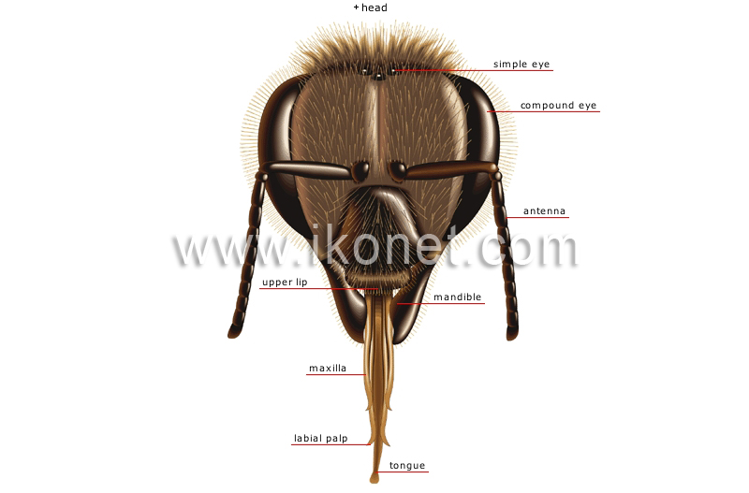

Slide 56
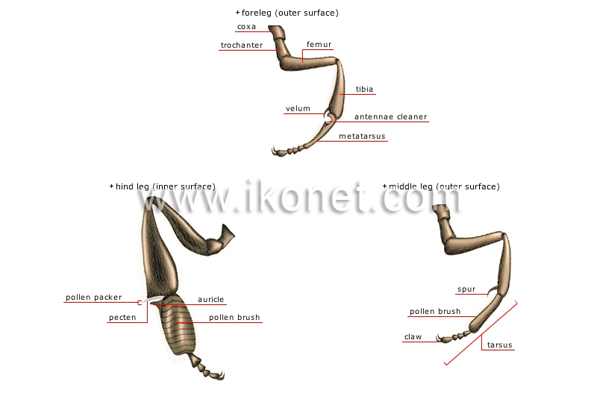

Slide 57
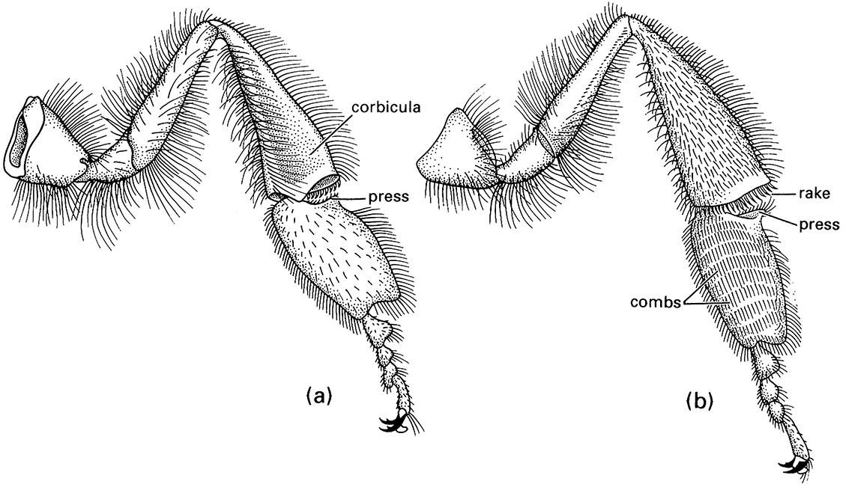

Slide 58
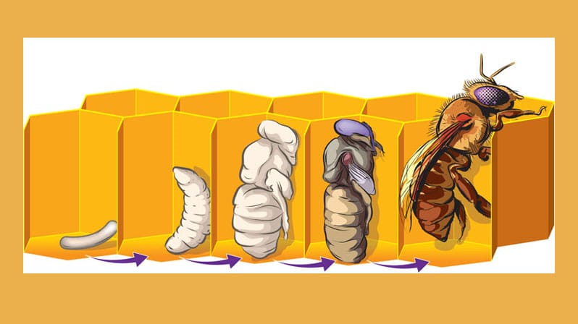
Life cycle of the worker bee

Slide 59
These develop from fertilized eggs through a complete metamorphosis
The queen bee lays the eggs in combs; which hatch into larvae.
They are first fed on royal jelly and then on a mixture of pollen and honey until they hatch into a pupa
The pupa develops into an adult after 20 days
Royal jelly is secreted from the salivary glands of worker bees.

Slide 60
Queen bees develop from fertilized eggs through a complete metamorphosis.
The queen lays eggs in special larger cells of the comb and they hatch into larvae.
They are fed on royal jelly only and moult into pupa.
These remain dormant and moult into adults.
The cycle lasts for 16 days

Slide 61
Drones develop from unfertilized eggs through a complete metamorphosis.
These eggs are laid by the queen into cells of the comb, hatch into larvae.
The larvae are first fed on royal jelly and then later on a mixture of honey and pollen.
They later change into pupae which remain dormant and moult into adults.
The cycle is 24 days long

Slide 62
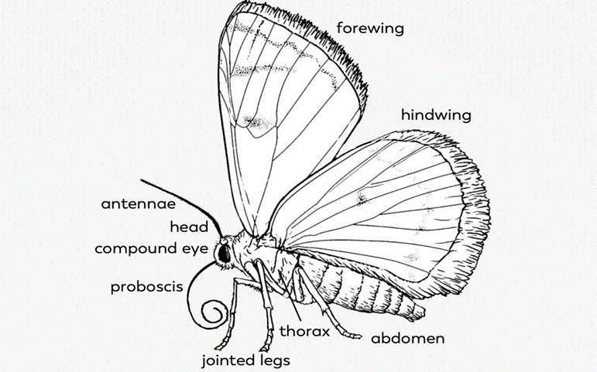
THE BUTTER FLY (Papilio demodocus)

Slide 63
HEAD
EYES | 1 pair of large compound eyes and two simple eyes
MOUTH PARTS | A long coiled proboscis
ANTENNAE | One pair of hairy, long and clubbed antennae
THORAX
WINGS | Two pairs of wings covered with small scales
LEGS | 3 pairs of hairy, jointed legs.
ABDOMEN | Hairy, segmented and elongated
HABITAT | Bushes
FOOD | Larvae feed on plant materials while adults feed on juices
NOTES | The whole body is hairy

Slide 64
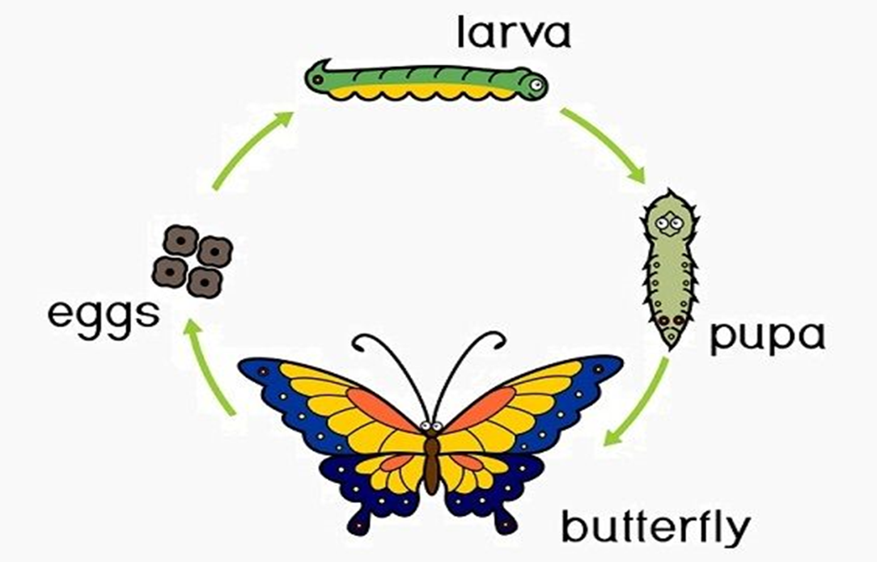
LIFE CYCLE

Slide 65
A butterfly undergoes complete metamorphosis.
After mating, the adult butterfly lays eggs on the underside of a leaf which hatch into larvae (caterpillars)
The caterpillar feeds on the leaf and moults into a pupa
The pupa remains dormant until it moults into an adult butter fly.
The life cycle takes up to 30 days or more

Slide 66
The Larva (Caterpillar) is the harmful stage of the butter fly
It is a very important pest that destroys mainly leaves and flowers
It can be controlled by spraying with insecticides
However, silk worms are sources of silk – an important raw material for the textile industry.
Adult butterflies participate in pollination of flowers

Slide 67
GENERAL IMPORTANCE OF INSECTS
1. They pollinate flowers e.g. bees, butterflies, etc.
2. Some are vectors that spread diseases e.g. ….
3. Some are parasites to plants and animals ….
4. Some are pests that destroy crops ….
5. Some improve soil aeration e.g. termites.

Slide 68
6. Some insects are sources of food for some organisms
7. Some insects are used by artists for decorations because of their beautiful colour patterns
8. They destroy his property like …..
9. Sources of industrial raw materials ….

Slide 69
REASONS WHY INSECTS ARE VERY SUCCESSFUL ORGANISMS
Have an exoskeleton made of chitin which protects the inner body parts of insects
The body is covered by a thin layer of cuticle to reduce water loss
Produce non toxic wastes hence conserving water.
Have an efficient respiratory system called the tracheal system for proper gaseous exchange

Slide 70
Insects show metamorphosis during growth which increases chances of survival
They have a variety of colours for camouflage to avoid predation
They are small sized with small food requirements. They can also easily hide from enemies
Most insects have wings which enable them to fly, thus easily escape from predators
They usually lay a large number of eggs which increases chances of survival.

Slide 71
USE OF DICOTOMOUS KEYS TO IDENTIFY INSECTS
You are provided with the following specimens
(Grasshopper (G), housefly (H), centipede (C) and termite (T);
Construct two possible dichotomous keys that can be used to identify the organisms

Slide 72
Solution
1(a) have wings………………………………………………… 2
(b) Have no wings……………………………………………. 3
2 (a) has four wings………………………………………… G
Has two wings…………………………………………………… H
3 (a) has six legs……………………………………………… T
Has more than six legs……………………………………… C

Slide 73
Exercise
1. You are provided with the following organisms;
Butterfly (A) worker bee (B) cockroach (C) termite (D) and housefly (E).
Construct a dichotomous key to identify the organisms.
2. You are provided with the following specimens, Cockroach (A), housefly (B), spider(C), worker bee (D) and millipede (E). Construct a dichotomous key to identify the specimens.

Slide 74
THE END
GOOD LUCK

